Slide 1
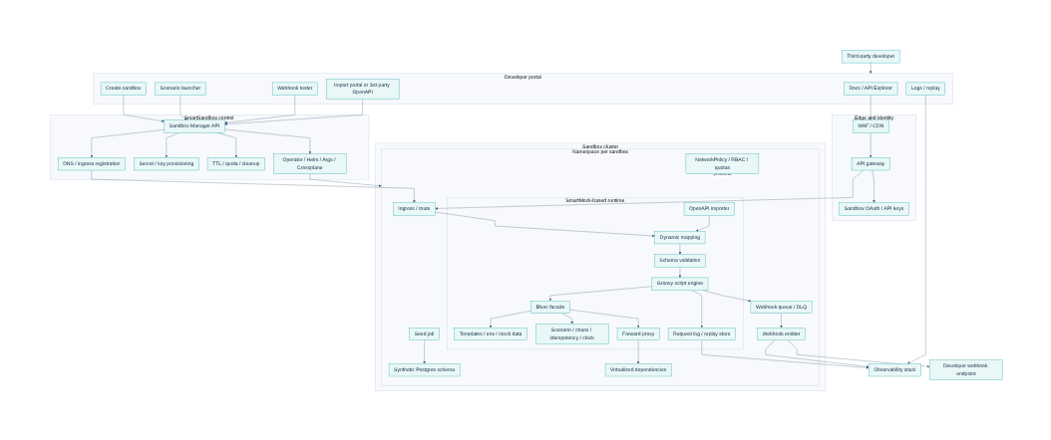
SmartSandbox
SmartSandbox Proposal
Architect board review: retained SmartMock core, isolated runtime per sandbox, portal-native control plane, and phased security-first delivery.
Audience: architect board review
SmartMock today → SmartSandbox target → market view → roadmap
Mermaid architecture view embedded in deck
Draft proposal
Notes:
Talk track - This deck goes deeper into platform boundaries, provisioning flow, runtime behavior, isolation, authoring controls, market position, and roadmap gates. - The purpose is to validate the target architecture and confirm which technical decisions must be locked before Phase 0 and Phase 1. [Sources] - Internal: Smart-Mock-Execution-Engine-Overview (1).md - Internal: ChatGPT-SmartSandbox summary.md - Internal: ChatGPT-Sandbox in developer portal (1).md - Internal: SmartSandbox_Architecture_Section_Consolidated.md

Slide 2
Architecture principles and target decisions
Architect board
Guiding choices
1. Retain SmartMock core
2. One runtime per sandbox
3. Namespace default
4. Safe authoring first
5. Phase-gated rollout
Use the existing execution engine for dynamic endpoint behavior instead of rewriting the runtime layer.
Isolation requirement plus external customization both point to a dedicated runtime for each sandbox.
Kubernetes namespace-per-sandbox is the default operating model; stronger runtime classes remain optional.
Default users get UI/DSL-based authoring; raw Groovy is a gated advanced mode with policy and audit.
Security hardening and platform controls precede broad programmable third-party usage.
Board focus
• Validate the platform boundary: what stays inside SmartMock vs what sits in the control plane.
• Validate isolation, tenancy, and database strategy for an unknown but enterprise-scale partner population.
• Validate the security posture for external authoring and whether advanced Groovy should remain optional.
• Validate that the roadmap gates are sufficient before exposing a programmable sandbox broadly.
SmartSandbox proposal
2/13
Notes:
Talk track - These are the architecture decisions that shape every later implementation choice. - The most important board question is not whether SmartMock is useful; it is whether the platform layers and authoring controls are strong enough for external partner use. - The decisions here intentionally limit scope creep by making programmable authoring gated rather than universal. [Sources] - Internal: SmartSandbox_Architecture_Section_Consolidated.md - Internal: Smart-Mock-Execution-Engine-Overview (1).md

Slide 3
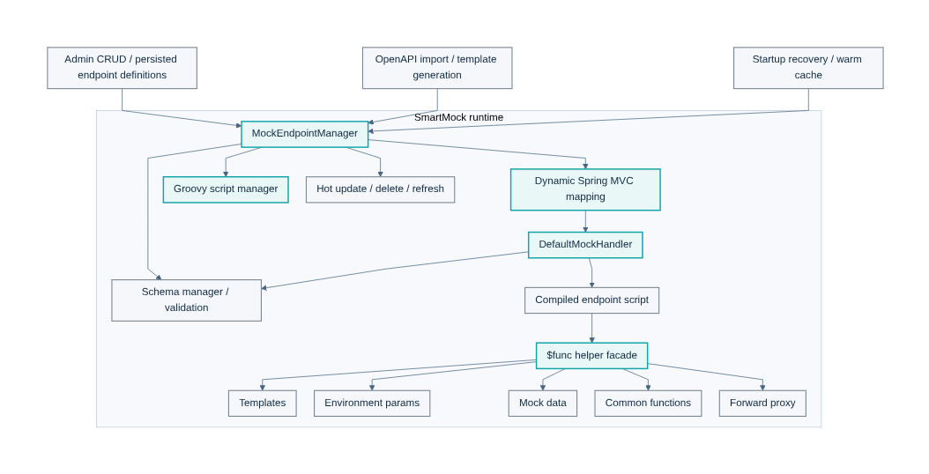
SmartMock current runtime architecture
Architect board
Current implementation baseline
Current capability
Dynamic Spring MVC mapping
OpenAPI import and template generation
Groovy compile, cache, and hot reload
Schema validation orchestration
Forward proxy
Templates, env params, mock data, common functions
Current risk notes
Script security is not shown as sandboxed in the runtime notes. The executor assumes upstream authentication and is not yet designed as an external multi-tenant programmable platform.
Mermaid diagram derived from SmartMock runtime documentation
SmartSandbox proposal
3/13
Notes:
Talk track - This slide is the runtime baseline the board should treat as proven capability. - The architecture already provides dynamic endpoint behavior, OpenAPI-driven provisioning, and hot update mechanics. - The board should also note the security caveat: the runtime docs themselves do not present Groovy as safely sandboxed for broad external programmable use. [Sources] - Internal: Smart-Mock-Execution-Engine-Overview (1).md

Slide 4
Gap analysis: SmartMock vs SmartSandbox
Architect board
What must be added
Already in SmartMock
Must be added in SmartSandbox
• Dynamic endpoint lifecycle management
• OpenAPI import and reusable templates
• Groovy runtime behavior and hot reload
• Schema validation and forwarding
• In-memory managers for env, mock data, and common functions
• No-restart refresh of endpoint behavior
• Sandbox Manager APIs and control plane
• Namespace / ingress / secret / quota provisioning
• Seeded synthetic data and scenario launcher
• Webhook queue, retry, DLQ, and replay UX
• Portal logs, traces, and request replay
• Tenant-safe external authoring controls and policy
• TTL, cost governance, and cleanup automation
Board interpretation — the gap is primarily platformization, tenancy, and secure externalization of capabilities, not the absence of a runtime core.
SmartSandbox proposal
4/13
Notes:
Talk track - This slide is the central argument for building SmartSandbox around SmartMock rather than replacing it. - The value of SmartMock is in runtime execution. The value missing for SmartSandbox is lifecycle, isolation, observability, portal workflow, and secure externalization. - That distinction matters because it changes the staffing profile and reduces rewrite risk. [Sources] - Internal: Smart-Mock-Execution-Engine-Overview (1).md - Internal: SmartSandbox_Architecture_Section_Consolidated.md

Slide 5
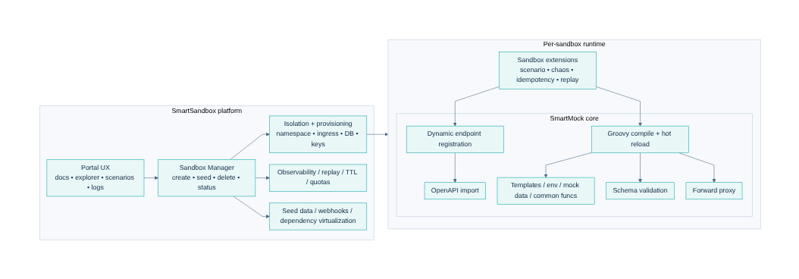
SmartMock ↔ SmartSandbox layering
Architect board
Platform boundary
Boundary rule
Platform responsibilities stay outside the runtime: lifecycle, tenancy, ingress, keys, quotas, seeded data, logs, replay, and portal orchestration.
Runtime rule
Behavior execution stays inside SmartMock: endpoint mapping, scripts, validation, forwarding, template and data helpers.
SmartSandbox platform layers surrounding the retained SmartMock runtime
Why it matters
This separation lets the board review control-plane hardening and runtime hardening independently.
SmartSandbox proposal
5/13
Notes:
Talk track - The layering is deliberate because it reduces coupling between developer portal workflows and runtime execution semantics. - It also creates a cleaner security model: control-plane permissions can be separated from runtime authoring and execution permissions. [Sources] - Internal: SmartSandbox_Architecture_Section_Consolidated.md

Slide 6
Detailed logical architecture
Architect board
Target component view
Detailed component architecture for the recommended SmartSandbox design
Board checks — validate control-plane scope, namespace-per-sandbox isolation, SmartMock runtime boundaries, webhook path, and observability handoff.
SmartSandbox proposal
6/13
Notes:
Talk track - This is the detailed target architecture: portal, edge, control plane, namespace-per-sandbox, runtime, data, webhooks, and observability. - The board should focus on whether any component belongs in a different trust boundary or whether any missing control-plane capability would become an operational blocker. [Sources] - Internal: SmartSandbox_Architecture_Section_Consolidated.md - Internal: ChatGPT-SmartSandbox summary.md - Internal: ChatGPT-Sandbox in developer portal (1).md

Slide 7
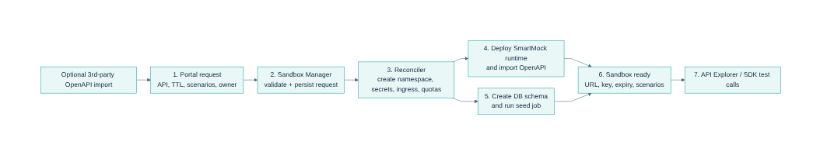
Provisioning and activation flow
Architect board
Control-plane sequence
Key control-plane steps
Validate request → create namespace / secrets / ingress → deploy runtime → seed database → return URL, key, expiry, and scenarios.
Board checks
Idempotent provisioning, teardown reliability, TTL cleanup, ingress registration, and dependency ordering between runtime deployment and seed jobs.
Provisioning sequence from portal request to ready sandbox
Open question
Should imported third-party OpenAPI be validated and normalized before a runtime is provisioned, or accepted as part of the sandbox creation path?
SmartSandbox proposal
7/13
Notes:
Talk track - The provisioning path is where operational and security errors become very expensive later, so the board should scrutinize it carefully. - The critical questions are idempotency, failure recovery, and whether external OpenAPI imports are validated before or during sandbox creation. [Sources] - Internal: SmartSandbox_Architecture_Section_Consolidated.md

Slide 8
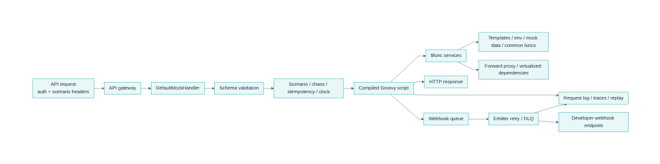
Runtime request execution flow inside one sandbox
Architect board
Execution path
Request handling, scenario controls, helper services, logs, and webhook delivery
Critical path concerns
Board interpretation
Request validation latency
Scenario determinism
Helper capability boundaries
Replay correlation IDs
Webhook retry / DLQ behavior
This flow proves SmartMock can remain the behavior engine while SmartSandbox adds higher-order controls around it.
SmartSandbox proposal
8/13
Notes:
Talk track - This is the per-request path the board should review for determinism, security boundary, and observability quality. - The goal is for runtime execution to stay simple enough to reason about while still supporting higher-fidelity partner testing such as webhooks and dependency virtualization. [Sources] - Internal: Smart-Mock-Execution-Engine-Overview (1).md - Internal: SmartSandbox_Architecture_Section_Consolidated.md

Slide 9
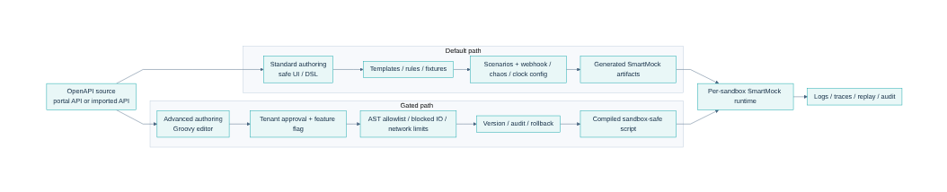
Authoring model and security controls
Architect board
Default-safe, advanced-gated
Standard mode
Default for most partners: templates, rules, fixtures, scenarios, chaos toggles, and webhook config through a safe UI or DSL.
Advanced mode
Approved tenants only: Groovy editor behind feature flags, validation, versioning, audit, and stricter runtime policy.
Default safe UI path and gated advanced Groovy path
Controls the board should require
AST / import allowlist • blocked file / process / reflection access • outbound network restrictions • runtime timeouts and memory limits • version / rollback • per-tenant policy
SmartSandbox proposal
9/13
Notes:
Talk track - The authoring model is the main security decision in this proposal. - The recommendation is to make safe UI-based authoring the norm and keep raw Groovy as a policy-controlled advanced mode. - This preserves differentiation without turning the first external release into an arbitrary-code platform. [Sources] - Internal: Smart-Mock-Execution-Engine-Overview (1).md - Internal: SmartSandbox_Architecture_Section_Consolidated.md

Slide 10
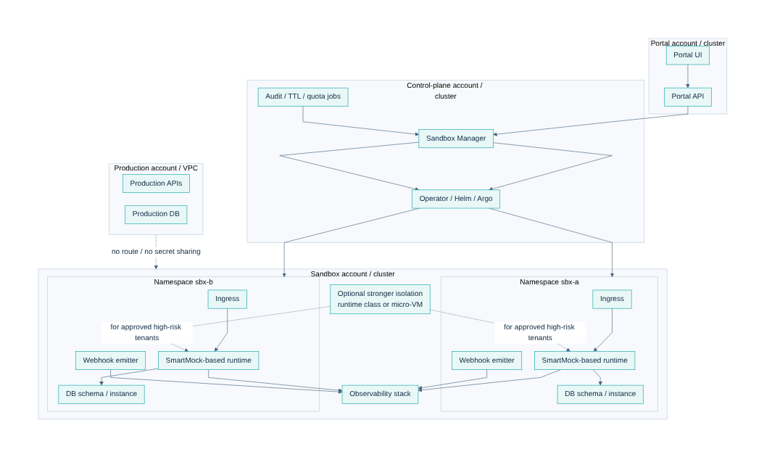
Deployment topology and isolation choices
Architect board
Operating model
Default
Sandbox account / cluster separated from production. Namespace-per-sandbox. Schema-per-sandbox database to start.
Optional
Stronger runtime class or micro-VM for approved high-risk programmable tenants.
Avoid
Direct routes or secret sharing with production VPCs and databases.
Portal, control plane, sandbox cluster, and production separation
Board decision
Confirm whether namespace isolation is sufficient for phase 1 and which tenant classes, if any, must require stronger runtime isolation from day one.
SmartSandbox proposal
10/13
Notes:
Talk track - This slide turns the architecture into an operating model with explicit trust boundaries. - The default recommendation is namespace-per-sandbox in a separate sandbox environment, with stronger runtime isolation reserved for policy-driven exceptions. [Sources] - Internal: ChatGPT-Sandbox in developer portal (1).md - Internal: SmartSandbox_Architecture_Section_Consolidated.md

Slide 11
Market landscape and positioning
Architect board
Directional synthesis from official docs reviewed today
Market view
Higher fidelity / control
SmartSandbox
ReadyAPI
WireMock
Microcks
MuleSoft
Apidog
Postman
Prism
Low
Ease / speed of adoption →
High
Directional synthesis based on official documentation; not a quantitative benchmark.
Architectural takeaway
If we market this as “mocking”, several tools will look simpler. If we market it as “isolated partner sandboxing with business-journey simulation”, the differentiation is materially stronger.
SmartSandbox proposal
11/13
Notes:
Talk track - The board should see the market in two clusters: lightweight mock tools and richer simulation or virtualization tools. - SmartSandbox sits above both only if we really deliver isolation, portal-native operations, replay, and partner-oriented workflows. - The strategic risk is being judged as a heavier and later mock server rather than as a differentiated sandbox platform. [Sources] - External: https://docs.wiremock.io/overview - External: https://docs.wiremock.io/openAPI/openapi - External: https://wiremock.org/docs/stateful-behaviour/ - External: https://microcks.io/ - External: https://learning.postman.com/docs/design-apis/mock-apis/tutorials/mock-with-examples - External: https://learning.postman.com/docs/design-apis/mock-apis/matching-algorithm - External: https://learning.postman.com/docs/design-apis/mock-apis/create-dynamic-responses - External: https://stoplight.io/open-source/prism - External: https://docs.apidog.com/mock-api-data-in-apidog-617869m0 - External: https://docs.apidog.com/mock-scripts-618209m0 - External: https://docs.mulesoft.com/api-experience-hub/simulating-api-calls-using-the-mocking-service - External: https://smartbear.com/product/ready-api/api-virtualization/

Slide 12
Detailed market comparison: build vs products
Architect board
Pros / cons synthesis
Product
Portal
self-service
Stateful /
scenario
Callbacks /
webhooks
Dependency
virtualization
Isolated runtime
per tenant
End-to-end
business journey
SmartSandbox
●
●
●
●
●
●
WireMock Cloud
○
●
●
◐
○
○
Microcks
○
●
●
◐
○
○
Postman
○
◐
○
○
○
○
Prism
○
○
●
○
○
○
Apidog
○
◐
○
○
○
○
MuleSoft
◐
○
○
○
○
○
ReadyAPI
○
◐
○
●
○
○
Legend: ● strong emphasis in reviewed docs ◐ partial / adjacent capability ○ light or not central in reviewed docs
Pros of building SmartSandbox
Cons / risks of building SmartSandbox
Portal-native partner onboarding
Per-sandbox isolation and policy control
Extend SmartMock into business-journey simulation
Heavier platform operations
Security hardening required for programmable tenants
Longer path to feature breadth than a lighter mock tool
SmartSandbox proposal
12/13
Notes:
Talk track - This table is a directional synthesis of what each product emphasizes in its reviewed documentation. - It is useful for board-level build-vs-buy framing, but should not be mistaken for a procurement scorecard or lab benchmark. - The main board conclusion should be that our proposal wins only if isolation, portal-native workflow, and partner observability are real in phase 1 and phase 2. [Sources] - External: https://docs.wiremock.io/overview - External: https://docs.wiremock.io/openAPI/openapi - External: https://microcks.io/ - External: https://learning.postman.com/docs/design-apis/mock-apis/tutorials/mock-with-examples - External: https://learning.postman.com/docs/design-apis/mock-apis/matching-algorithm - External: https://stoplight.io/open-source/prism - External: https://docs.apidog.com/mock-api-data-in-apidog-617869m0 - External: https://docs.apidog.com/mock-scripts-618209m0 - External: https://docs.mulesoft.com/api-experience-hub/simulating-api-calls-using-the-mocking-service - External: https://smartbear.com/product/ready-api/api-virtualization/

Slide 13
Roadmap, open decisions, and board asks
Architect board
Phase gates
Phase 0
Phase 1
Phase 2
Phase 3
hardening
MVP sandbox
fidelity
excellence
• Per-sandbox packaging
• Tenant context + audit
• Authoring controls
• Create / seed / expire
• Namespace isolation
• Logs + replay + webhook ops
• Imported 3rd-party OpenAPI
• Dependency virtualization
• Scenario expansion
• Record-replay
• Time travel
• Premium isolation tier
Open decisions
Board asks
Raw Groovy exposure policy
Schema-per-sandbox vs instance-per-sandbox thresholds
Tenant classes needing stronger isolation
Exact phase-1 scope and commercial pilot cohort
Approve the target boundary and phase order
Confirm default isolation model
Approve policy-gated advanced authoring
Authorize Phase 0 / Phase 1 planning baseline
SmartSandbox proposal
13/13
Notes:
Talk track - The board does not need to approve every later differentiator now, but it does need to approve the architecture boundary, isolation default, and the policy approach to advanced authoring. - Phase 0 and Phase 1 are the minimum coherent path to a production-grade SmartSandbox baseline. [Sources] - Internal: SmartSandbox_Architecture_Section_Consolidated.md - Internal: ChatGPT-SmartSandbox summary.md

Slide 14
Strategic Evolution: Developer Portal + SmartMock + SmartSandbox
• HSBC Developer Portal already covers API discovery and partner onboarding.
• SmartMock provides reusable Open Banking simulation runtime capability.
• SmartSandbox adds lifecycle management, isolation, scenarios, dynamic data and governance.

Slide 15
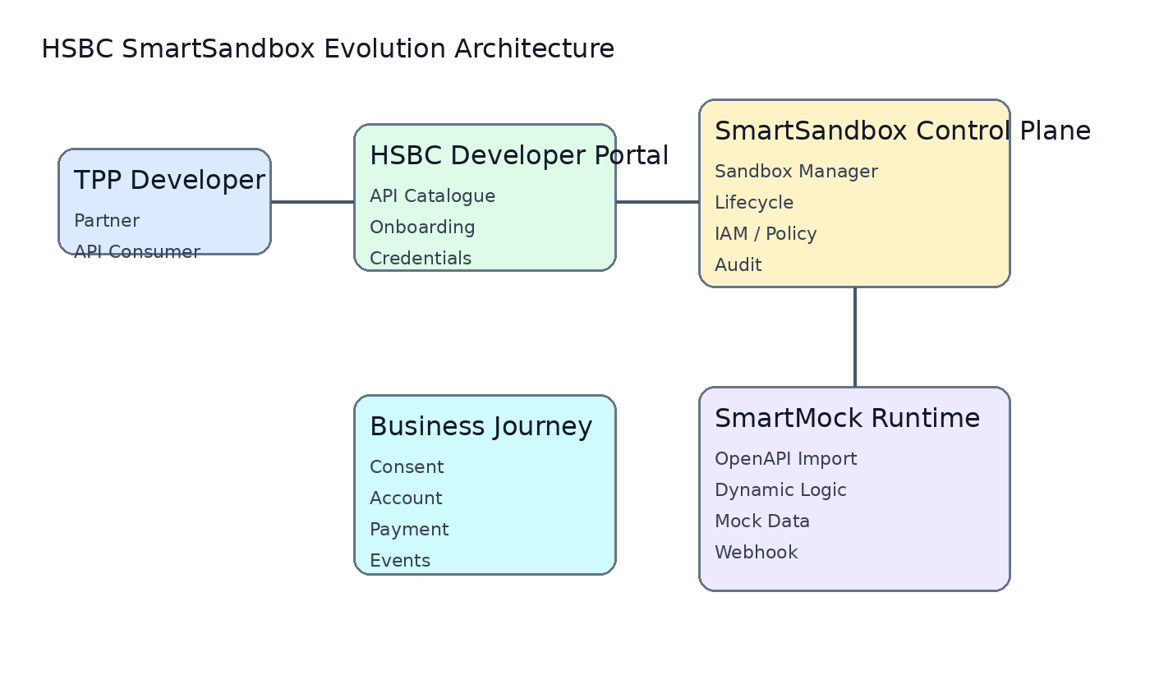
Target Architecture: SmartMock evolves into SmartSandbox
• Control Plane manages sandbox lifecycle.
• SmartMock remains the execution engine.
• Journey simulation enables consent, payment and event testing.

Slide 16
Major Comparison: DAC / DigitalAPI vs HSBC SmartSandbox
• DAC provides a mature Open Banking sandbox.
• HSBC advantage is existing portal ownership and SmartMock extensibility.
• Differentiation: end-to-end business journey simulation.
Capability | DAC | HSBC SmartSandbox
Portal | Vendor | HSBC owned
HKMA P3 | Supported | Proven
Consent | Standard | Custom journey
Dynamic Data | Configurable | State simulation
Custom Logic | Limited | SmartMock
Ownership | Vendor | HSBC

Slide 17
Long Term Roadmap: SmartMock -> SmartSandbox
• Phase 0: SmartMock hardening.
• Phase 1: Sandbox platform MVP.
• Phase 2: Advanced simulation.
• Phase 3: AI intelligent sandbox.

